Slide 1
Java Operators

Slide 2
Java operators are symbols or keywords that perform operations on variables and values. They are broadly categorized into the following types:
1 - Arithmetic Operators
2 - Relational (Comparison) Operators
3 - Logical Operators
4 - Assignment Operators
5 - Unary Operators
6 - Bitwise Operators
7 - Ternary Operator
8 - Instanceof Operator

Slide 3
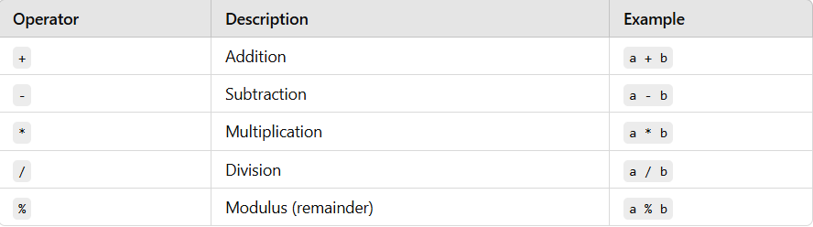
1. Arithmetic Operators
Used to perform basic mathematical operations.

Slide 4
Example-
public class ArithmeticExample {
public static void main(String[] args) {
int a = 10, b = 5;
System.out.println("Addition: " + (a + b)); // 15
System.out.println("Subtraction: " + (a - b)); // 5
System.out.println("Multiplication: " + (a * b)); // 50
System.out.println("Division: " + (a / b)); // 2
System.out.println("Modulus: " + (a % b)); // 0
}
}

Slide 5
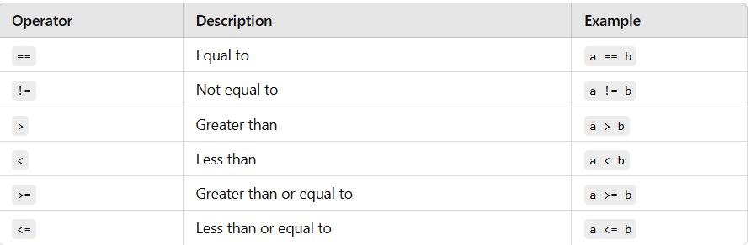
2. Relational (Comparison) Operators
Used to compare two values.

Slide 6
Example-
public class RelationalExample {
public static void main(String[] args) {
int a = 10, b = 5;
System.out.println("Equal to: " + (a == b)); // false
System.out.println("Not equal to: " + (a != b)); // true
System.out.println("Greater than: " + (a > b)); // true
System.out.println("Less than: " + (a < b)); // false
System.out.println("Greater than or equal to: " + (a >= b)); // true
System.out.println("Less than or equal to: " + (a <= b)); // false
}
}

Slide 7
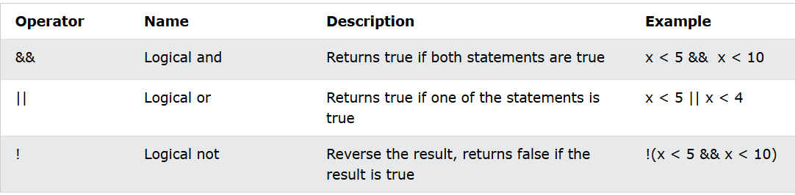
3. Logical Operators
Used for logical operations.

Slide 8
Example-
public class LogicalExample {
public static void main(String[] args) {
int a = 10, b = 5, c = 15;
// Logical AND: true if both conditions are true
System.out.println("Logical AND: " + ((a > b) && (c > a))); // true
// Logical OR: true if at least one condition is true
System.out.println("Logical OR: " + ((a < b) || (c > a))); // true
// Logical NOT: reverses the truth value
System.out.println("Logical NOT: " + !(a > b)); // false
}
}

Slide 9
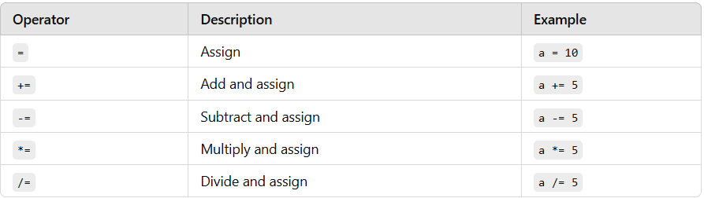
4. Assignment Operators
Used to assign values to variables.

Slide 10
Example –
public class AssignmentExample {
public static void main(String[] args) {
int a = 10;
a += 5; // a = a + 5
System.out.println("a after +=: " + a); // 15
a -= 2; // a = a - 2
System.out.println("a after -=: " + a); // 13
a *= 2; // a = a * 2
System.out.println("a after *=: " + a); // 26
a /= 2; // a = a / 2
System.out.println("a after /=: " + a); // 13
}
}

Slide 11
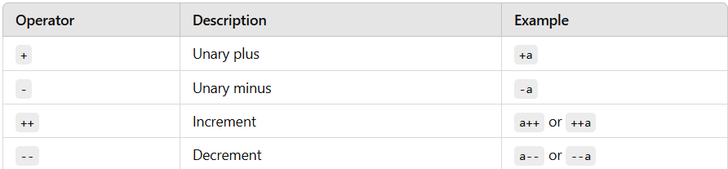
5. Unary Operators
Operate on a single operand.

Slide 12
Example –
public class UnaryExample {
public static void main(String[] args) {
int a = 10;
System.out.println("Post-increment: " + a++); // 10 (prints, then increments)
System.out.println("After Post-increment: " + a); // 11
System.out.println("Pre-increment: " + ++a); // 12 (increments, then prints)
System.out.println("Unary minus: " + (-a)); // -12
}
}

Slide 13
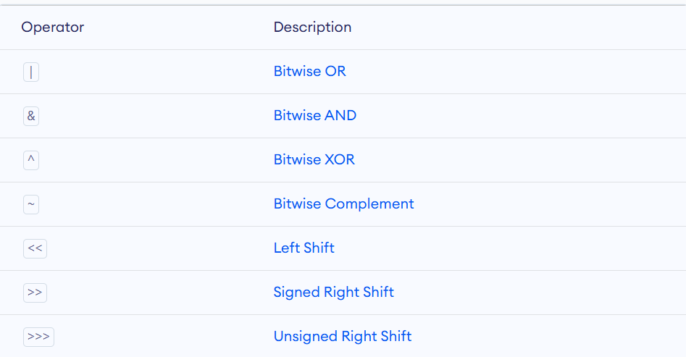
6. Bitwise Operators
Bitwise operators are used to performing the manipulation of individual bits of a number.

Slide 14
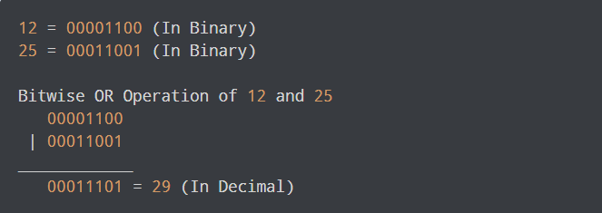
Bitwise OR Operator
The bitwise OR | operator returns 1 if at least one of the operands is 1. Otherwise, it returns 0.
Let's look at the bitwise OR operation of two integers 12 and 25.
Notes:
Example-
class Main {
public static void main(String[] args) {
int number1 = 12, number2 = 25, result;
// bitwise OR between 12 and 25
result = number1 | number2;
System.out.println(result); // prints 29
}
}

Slide 15
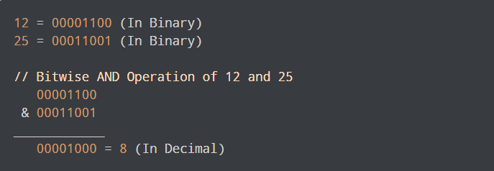
Bitwise AND Operator
The bitwise AND & operator returns 1 if and only if both the operands are 1. Otherwise, it returns 0.
Notes:
class Main {
public static void main(String[] args) {
int number1 = 12, number2 = 25, result;
// bitwise AND between 12 and 25
result = number1 & number2;
System.out.println(result); // prints 8
}
}

Slide 16
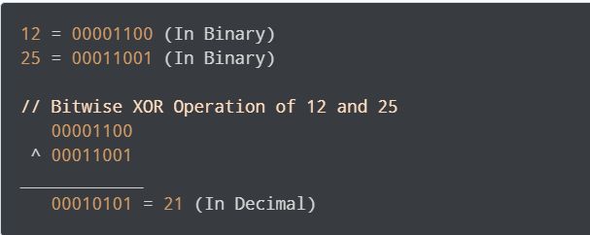
Bitwise XOR Operator
The bitwise XOR ^ operator returns 1 if and only if one of the operands is 1. However, if both the operands are 0 or if both are 1, then the result is 0.
Notes:
class Main {
public static void main(String[] args) {
int number1 = 12, number2 = 25, result;
// bitwise XOR between 12 and 25
result = number1 ^ number2;
System.out.println(result); // prints 21
}
}

Slide 17
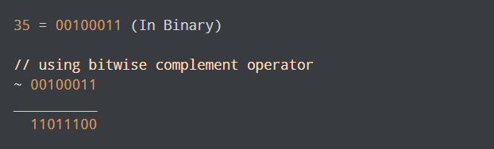
Bitwise Complement Operator
The bitwise complement operator is a unary operator (works with only one operand). It is denoted by ~.
It changes binary digits 1 to 0 and 0 to 1.
It is important to note that the bitwise complement of any integer N is equal to - (N + 1). For example,
Consider an integer 35. As per the rule, the bitwise complement of 35 should be -(35 + 1) = -36. Now let's see if we get the correct answer or not.
In the above example, we get that the bitwise complement of 00100011 (35) is 11011100. Here, if we convert the result into decimal we get 220.

Slide 18
However, it is important to note that we cannot directly convert the result into decimal and get the desired output. This is because the binary result 11011100 is also equivalent to -36. Let's understand it -
The result 11011100 is a signed 8-bit binary number. The leftmost bit (1) indicates that it's a negative number (in the case of an 8-bit signed integer, the leftmost bit determines whether the number is positive or negative).
To find out what negative number 11011100 represents, you need to convert it to its positive equivalent by following the 2's complement process:
Invert the bits of 11011100: 00100011
Add 1: 00100011 + 1 = 00100100 (which is 36 in decimal).
Since the original leftmost bit indicated that it's negative, the number is -36.
Notes:
in binary systems, negative numbers are often stored using 2's complement. In 2's complement, the bitwise complement of a positive number (e.g., 35 → 00100011) results in a negative number when represented in binary, not a positive number. That’s why 11011100 is interpreted as -36 instead of a positive 220.

Slide 19
Example –
class Main {
public static void main(String[] args) {
int number = 35, result;
// bitwise complement of 35
result = ~number;
System.out.println(result); // prints -36
}
}

Slide 20
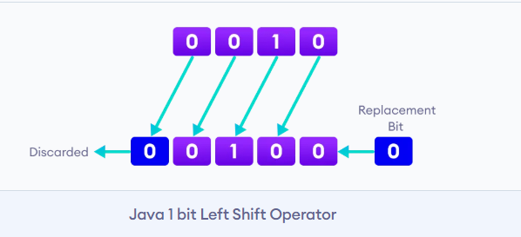
Left Shift Operator
The left shift operator shifts all bits towards the left by a certain number of specified bits. It is denoted by <<.
As we can see from the image above, we have a 4-digit number. When we perform a 1 bit left shift operation on it, each individual bit is shifted to the left by 1 bit.
As a result, the left-most bit (most-significant) is discarded and the right-most position(least-significant) remains vacant. This vacancy is filled with 0s.

Slide 21
Example –
class Main {
public static void main(String[] args) {
int number = 2;
// 2 bit left shift operation
int result = number << 2;
System.out.println(result); // prints 8
}
}

Slide 22
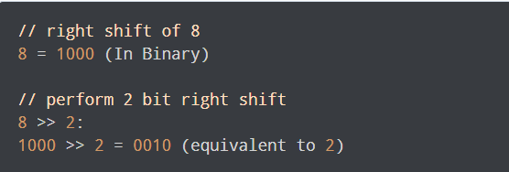
Signed Right Shift Operator
The signed right shift operator shifts all bits towards the right by a certain number of specified bits. It is denoted by >>.
When we shift any number to the right, the least significant bits (rightmost) are discarded and the most significant position (leftmost) is filled with the sign bit. For example,
Here, we are performing the right shift of 8 (i.e. sign is positive). Hence, there no sign bit. So the leftmost bits are filled with 0 (represents positive sign).

Slide 23
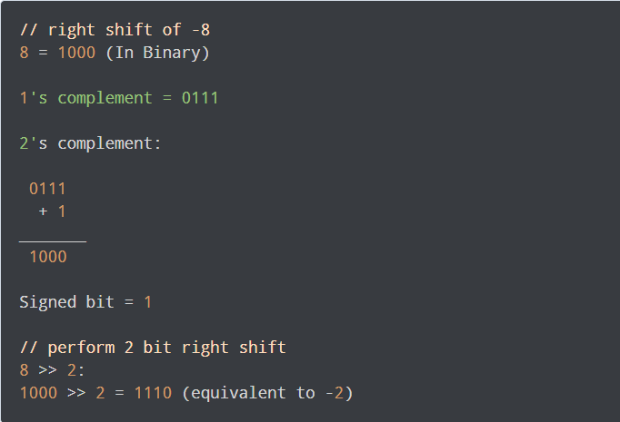
Here, we have used the signed bit 1 to fill the leftmost bits.
The result will be -2 (by 2’s complement of 1110)
Notes:
Invert the bits of 1110: 1110 → 0001
Add 1 to the inverted bits: 0001 + 1 = 0010
Interpret the result: The binary 0010 is 2 in decimal. Since we started with a negative number (the leftmost bit was 1), the result is -2.

Slide 24
Example –
class Main {
public static void main(String[] args) {
int number1 = 8;
int number2 = -8;
// 2 bit signed right shift
System.out.println(number1 >> 2); // prints 2
System.out.println(number2 >> 2); // prints -2
}
}

Slide 25
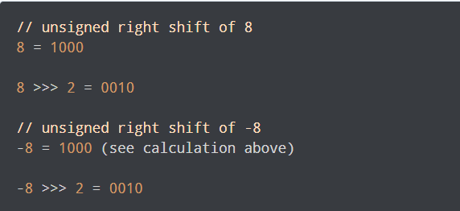
Unsigned Right Shift Operator
Java also provides an unsigned right shift. It is denoted by >>>.
Here, the vacant leftmost position is filled with 0 instead of the sign bit. For example,

Slide 26
Example –
class Main {
public static void main(String[] args) {
int number1 = 8;
int number2 = -8;
// 2 bit signed right shift
System.out.println(number1 >>> 2); // prints 2
System.out.println(number2 >>> 2); // prints 1073741822
}
}

Slide 27
7. Ternary Operator
Shorthand for an if-else statement.
Example –
public class TernaryExample {
public static void main(String[] args) {
int a = 10, b = 20;
int max = (a > b) ? a : b;
System.out.println("Maximum: " + max); // 20
}
}

Slide 28
8 - Instanceof Operator
Used to check if an object is an instance of a particular class.
Example –
String str = "Hello";
System.out.println(str instanceof String); // true

